Slide 1
Project Management Operations
MSPM1-GC2030
Session Number 1
Course Introduction and Overview

Slide 2

Agenda
Introductions
Icebreaker
Course Overview
NYU Classes Tour
Assignments Tour
Project conflict
Assignment 1
Project Intake Tour

Slide 3


.
MSPM1- GC2030.100 Spring 2021 Course Timeline
Class Starts
Wednesday, 2/03
.
.
Teams Assigned
Final Exam
5/5
.
Random selection
2/10
Midterm Exam
3/10
Last day of class
.
Individual Project
Proposal
Due
2/17
.
Individual
WBS &
Schedule
Due
2/24
.
.
Team
Written
Report &
Presentation
Due
4/28
.
Team
Detailed Budget Due
4/7
.
Team
RFP
Due
4/21
Start
.
.
.
.
.
.
…
.
.
..
.
.
.
.
.
.
.
1
2
3
4
5
6
7
8
9
10
11
12
13
14
.
Scope - 02/10/21
Overview- 2/03/21
Scheduling - 2/24/21
Final Exam - 5/05/21
Workplan - 02/17/21
Procurement – 4/07/21
Mid-Term Exam - 3/10/21
End
Integrated Change Control 3/03/21
Control: Accounting Skills – 3/31/21
Develop a Operating Budget – 3/24/21
Feedback: Lessons Learned – 4/28/21
Negotiations, Problem Solving – 4/21/21
Grades posted within 72 hours of final exam
Planning and Budgeting Road map - 3/17/21
Contracts /Vendors Relations -4/14/21
.
* Note: All classes meet on Wednesdays.

Slide 4

Introductions & Ice Breaker
Notes:
Students interview eachother and then introduce their interviewee to the class. Students tell 2 truths and a lie.

Slide 5
Team & Project Selection
Dated: 2/3/2020
Version 1 – p. 1 of 2
Wednesday
MSPM1 GC2030.100– Project Management Operations – Spring 2021
 | Student | Team # | Current City Location | Interest #1 | Interest #2 | Select a proposal theme
 |  |  |  |  |  | US Digital | Hotel venture | Another idea? Advise by 2/8
1 | Chen, Guang
2 | Chuang, Andy
3 | Garcia, Daniela
4 | Lin, Emily
5 | Liu, HanBang
6 | Lu, Yuchen
7 | Navanit, Namrata
8 | Nguyen, Astrid
9 | Perez Cruz, Ilean
10 | Rao, Shuen
11 | Rodriguez, Helena
12 | Santana, Lennys Awilda
13 | Shirodkar, Sneha
14 | Tchir, Naomi
15 | Ulloa, Johana
16 | Van de Kerckhove, Mathias

Slide 6
Team & Project Selection
Dated: 2/3/2020
Version 1 – p. 2 of 2
Wednesday
MSPM1 GC2030.100– Project Management Operations – Spring 2021
 | Student | Team # | Current City Location | Interest #1 | Interest #2 | Select a proposal theme
 |  |  |  |  |  | US Digital | Hotel venture | Another idea? Advise by 2/8
17 | Wang, Reo
18 | Yang, Jifan
19 | Yang, Yufan
20 | Zhou, Junda

Slide 7

Today’s Deep Dive Exercise
What is your mindset as it relates to your PM career?
.
Click survey:
https://nyu.qualtrics.com/jfe/form/SV_0DlfDLxrQAU4dPo
1. What city are you from? Where are you located now?
2. What inspires you? What interest you? Any hobbies?
3. What are your concerns?
4. What new skills do you need to achieve your goals?
5. What industry are you in? What industry do you want?
6. What work or project experience do you have?
7. How will your prior experience(s) help you succeed?
8. What do you expect to learn in this course?
7

Slide 8
Course Overview:
Review syllabus
NYU Classes tour
Preference on course timing (breaks, due dates)
Zoom

Slide 9
Project Management Operations:
Course Topics:
Overview
Scope
Workplan
Schedule
Change Control
Capital Budget
Operating Budget
Variance Analysis
Earned Value Management
Procurement
Vendor Relations
Negotiations
Problem Solving
Lessons Learned
Notes:
Conflict in Projects Caused by:
Schedule
Management wants a certain timeline vs. actual WBS
Keeping the team on schedule
Scope
What we need to do
Understanding what people want vs. self-report
Budget
Ways to justify budget
Real-life budget
Given a budget or build a budget

Slide 10
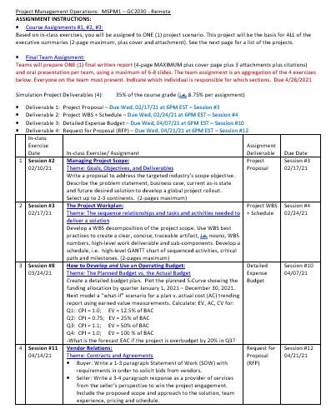
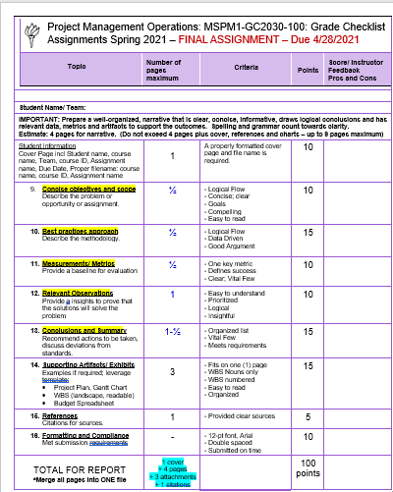
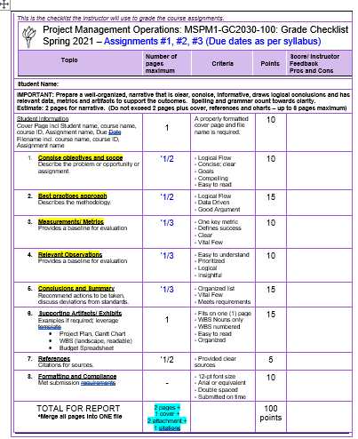
Assignments: Rubric
Located in the Syllabus Tab

Slide 11

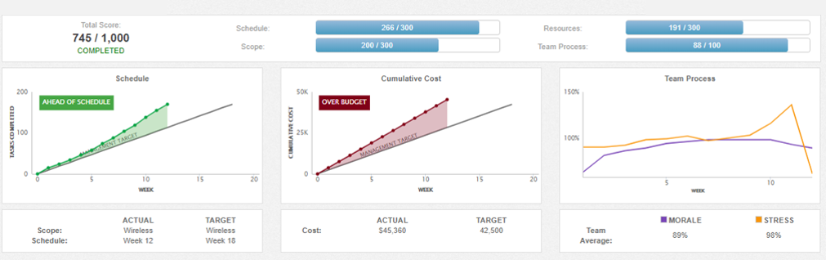
Game Simulation: Earned Value Management
Located in the Syllabus Tab

Slide 12
Course Theme - Constraints:
Scope
Schedule
Budget
Notes:
Conflict in Projects Caused by:
Schedule
Management wants a certain timeline vs. actual WBS
Keeping the team on schedule
Scope
What we need to do
Understanding what people want vs. self-report
Budget
Ways to justify budget
Real-life budget
Given a budget or build a budget

Slide 13

Understand the
Drivers for
Change:
PROJ1-CE?? - ???
Instructor: Yael Israel
MSPM1-GC2010-100
Instructor: Yael Israel
Cost savings
Revenue
Efficiency
Regulatory
Pure innovation
13

Slide 14
Scope
This section contains foundational content needed from introductory course study.

Slide 15
Project Components Define Scope
A clear statement of purpose
Requirements
Specifications
Deliverables
Objectives

Slide 16
Well Defined Scope
Represents the expectations of stakeholders
Helps assess the resource requirements
Is sensitive to constraints
Helps to make realistic commitments
Defines the boundary of the project
Facilitates the planning process

Slide 17
Scope Creep
Uncontrolled growth of functionality
Requirements churn and expansion
Inadequate prioritization
Schedule delays
Cost increases
Quality problems
Misdirected energy and morale

Slide 18
Project Scope Management Processes
Scope Planning: The basis for future decisions
Collect Requirements: The discovery phase of a project
Scope Definition: Subdivisions of the project deliverables
Scope Verification: Formal acceptance of the project scope
Scope Change Control: Monitor changes to project scope

Slide 19
Scope Planning
Improve the accuracy of time, cost, and resource estimates
Defines a baseline for performance measurement and project control
Aid in communicating clear work responsibilities

Slide 20

Collect Requirements
Information Gathering
Clarify features and functions
Establish look and feel
The User Expectations (UX)
Document the requirements in sufficient detail
Trace their status from the planning, to the execution, to the delivery of results

Slide 21
Scope Definition
The business need
The product or service to be delivered
What is in scope and what is out of scope
Project goals and objectives
The project critical success factors
Project constraints
What is the compelling problem to address?
What is the story we need to focus on?

Slide 22
This page left blank intentionally.
Foundational content from the introductory PM course study ends

Slide 23
.
Content in this section resumes for
Project Management Operations MSPM1-GC2030
Notes:
Conflict in Projects Caused by:
Schedule
Management wants a certain timeline vs. actual WBS
Keeping the team on schedule
Scope
What we need to do
Understanding what people want vs. self-report
Budget
Ways to justify budget
Real-life budget
Given a budget or build a budget

Slide 24
Other constraints: Project Conflict Caused by
Resources (Staffing)
Risk
Quality
Notes:
Conflict in Projects Caused by:
Schedule
Management wants a certain timeline vs. actual WBS
Keeping the team on schedule
Scope
What we need to do
Understanding what people want vs. self-report
Budget
Ways to justify budget
Real-life budget
Given a budget or build a budget

Slide 25
Risk Identification: Reasons Projects Fail
Understand the risks and propose solutions
Politics
Optimism
Start Up Mentality
Bravado
Globalization
New Technology
Unexpected Government Regulations
Crises
Any others?
Notes:
Conflict in Projects Caused by:
Schedule
Management wants a certain timeline vs. actual WBS
Keeping the team on schedule
Scope
What we need to do
Understanding what people want vs. self-report
Budget
Ways to justify budget
Real-life budget
Given a budget or build a budget

Slide 26


Evaluate Case Study for a
“real-world” scenario
Located in the Resources Tab
Under Case Study
Notes:
https://docs.google.com/document/d/134dSUYR1gU0xB_qeIvnUiBEMGGYnpHJPHacJhlcywDM/edit

Slide 27
Evaluate Case Study for a
“real-world” scenario
Located in the Resources Tab
Under Case Study
In-class exercise:
Read the case study
Research the industry via Google, Bing, etc.
Create a proposal to address the hotel targets
Apply the Project Proposal Template
- What are the key drivers for the project?
- What is the problem? Why is it important?
Notes:
https://docs.google.com/document/d/134dSUYR1gU0xB_qeIvnUiBEMGGYnpHJPHacJhlcywDM/edit

Slide 28
Scope Definition
What is the compelling problem to address?
What is the story we need to focus on?
Know the industry and the facts
As an example:
    Hotel Ownership Types
    Competition
    Locations
    Revenues
    Consumer Demand
    Company Pain Points

Slide 29
Marriott International Inc.
10400 Fernwood Rd.
Bethesda, Md. 20817
www.marriott.com
Link: https://www.washingtonpost.com/wp-srv/business/post200/2005/MAR.html
Source: © 2005 The Washington Post Company
Year founded: 1927 Industry: Hospitality/travel
Post 200 Category: Top 125 Companies
Revenue: $10.10 Billion
Net Income/Loss: $596.00 Million
Earnings per share: $2.48
Dividend: $0.33
Stockholder equity: $4.08 Billion
Auditor: Ernst & Young LLP
Stock: MAR
Assets: $8.67 Billion
Market capitalization: $15.09 Billion
52-week high: 69.22 4/13/2005
52-week low: 43.38 4/21/2004
Chairman and CEO: J.W. Marriott Jr.
President and COO: William J. Shaw
Employees: 133000
Local employees: 13165
Notes:
Conflict in Projects Caused by:
Schedule
Management wants a certain timeline vs. actual WBS
Keeping the team on schedule
Scope
What we need to do
Understanding what people want vs. self-report
Budget
Ways to justify budget
Real-life budget
Given a budget or build a budget

Slide 30
Marriott International Inc.
10400 Fernwood Rd.
Bethesda, Md. 20817
www.marriott.com
Description: Marriott is the world's biggest hotel company. It manages more than 2,600 properties under brand names that include Marriott, J.W. Marriott, Renaissance, Ritz-Carlton, Residence Inn, Courtyard and Fairfield Inn. It also operates time-share vacation resorts, corporate housing and conference centers.
Developments: Few companies benefited more from the return of the travel business last year than Marriott, as operating income from its lodging business rose 20 percent. It reflected, the company said, an improving economy, the return of business travelers, and consumers more inclined to take trips than any time since the Sept. 11, 2001, terrorist attacks. Its earnings rose 19 percent in 2004, to $596 million. With its business recovering, Marriott is pushing for aggressive investment in its properties, particularly to persuade owners and franchisees of the hotels that carry its brands to invest in better design, along with improved restaurants, spas and other amenities. Most of those changes will take place over many years, but Marriott is moving more aggressively with one project: It is insisting that owners and franchisees spend $190 million on new, 300 thread-count sheets, duvet covers and other bedding in 2,400 hotels by the end of 2005. Marriott added 166 new hotels with 27,000 rooms in 2004, continuing its aggressive expansion abroad, especially in China, with the opening of the Renaissance Suzhou Hotel in February. Closer to home, Marriott is set to manage a large hotel that D.C. officials seek to build next to the Washington Convention Center, although that plan has been bogged down in political skirmishes over the past year.
Link: https://www.washingtonpost.com/wp-srv/business/post200/2005/MAR.html
Source: © 2005 The Washington Post Company
Notes:
Conflict in Projects Caused by:
Schedule
Management wants a certain timeline vs. actual WBS
Keeping the team on schedule
Scope
What we need to do
Understanding what people want vs. self-report
Budget
Ways to justify budget
Real-life budget
Given a budget or build a budget

Slide 31
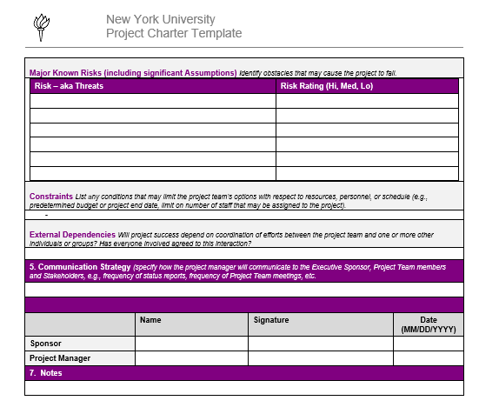
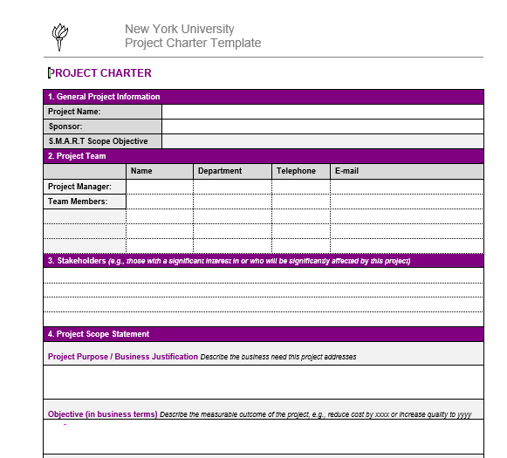
Assignment 1: Write a compelling proposal
- Discuss as a group
- Submit as an individual
Located in the Resources Tab
Under Examples and Templates:
“Project Charter Template Blank NYU”

Slide 32
Assignment 1: Project Proposal
Project proposal rubric
Example of completed proposal
Located in the Resources Tab
Under Examples and Templates:
“Project Charter NYU DOT Example”

Slide 33
Screen Tour: Automated Project Intake
https://www.nyu.edu/about/leadership-university-administration/office-of-the-president/office-of-the-executivevicepresident/information-technology/program-services/toolkit.html

Slide 34

Session Recap
Obtain course books
Familiarize yourself with NYU Classes / Syllabus
Tests contain material from readings and in-class discussions
Reading due for next class

